Slide 1
Project on: Weather Forecast
Presented By
Md. Rafsan Jaany
Supervised By:
Jesmin Akther
Md. Raihan Ali
Md. Razib Mondol
Id: 180222018
Id: 180222024
Id: 180222025
Lecturer, Dept. of CSE,
European University of Bangladesh
Thursday 4th November 2021

Slide 2
Outline
Introduction
Related Works
Motivation for The Work
Objective
Approach
How works the system
Date of completion
Conclusion

Slide 3
Introduction
Weather Forecasting Android Application
5 Days Forecasting
Daily weather update
City wise weather information

Slide 4
Related Works
Title: “আবহাওয়া”
Type: Android Application
Their Work Principle | Our Work Principle
Detect weather of today, tomorrow and four days of weather prediction. | Detect weather of today and five days (three hours interval) of weather prediction.

Slide 5
Motivation
Rainfall Prediction.
Well organized weather forecast for Bangladesh.
No need to check google for weather over and over again.

Slide 6
Objective
Helps people prepare if they need to take extra gear to prepare for the weather (i.e., umbrella, rain coat, sun screen).
Helps people plan outdoor activities (i.e., to see if rain/storms/cold weather will impact outdoor event)
Helps curious people to know what sort of weather can be expected (i.e., severe storms).
Helps businesses plan for transportation hazards that can result from the weather (i.e., fog, storms, clouds as it relates to driving and flying for example).
Helps people with health-related issues to plan the day (i.e., allergies, asthma, heat stress).

Slide 7

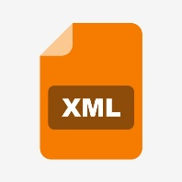


Approach
Platform/Framework | Backend | GUI | Database/API
Native Android with Android Studio | Java | XML | OpenWeather

Slide 8
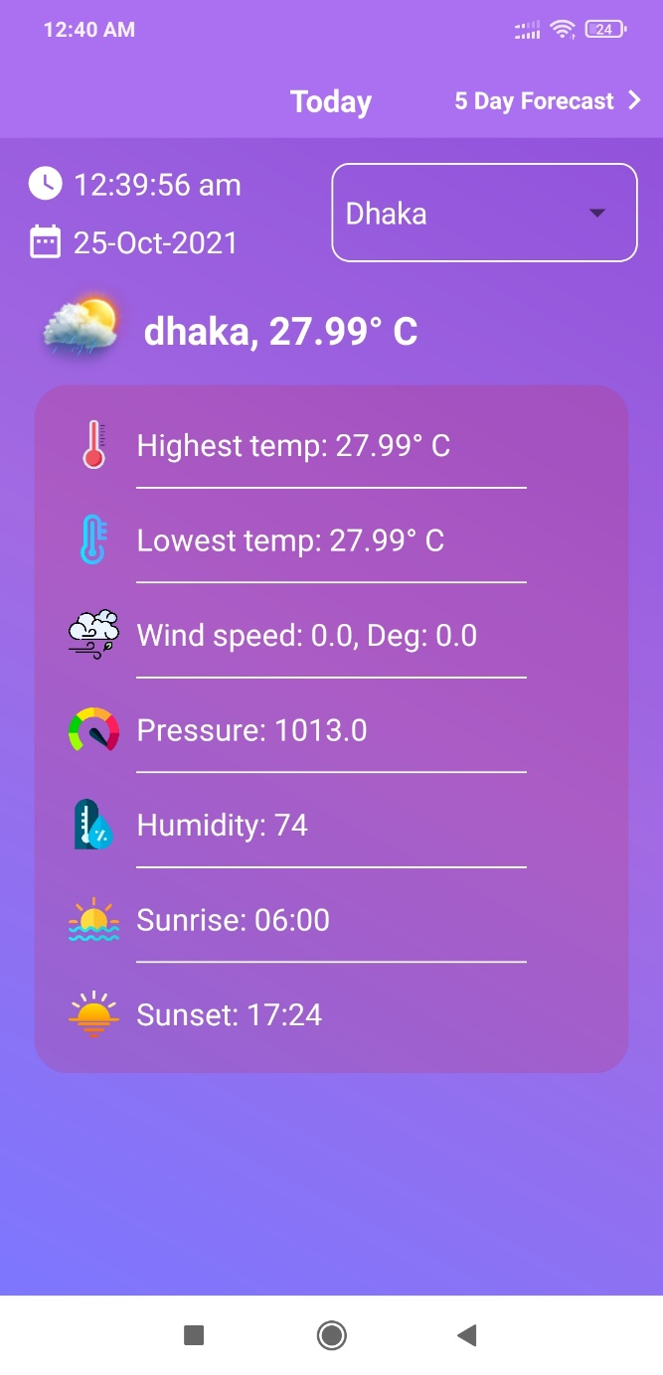
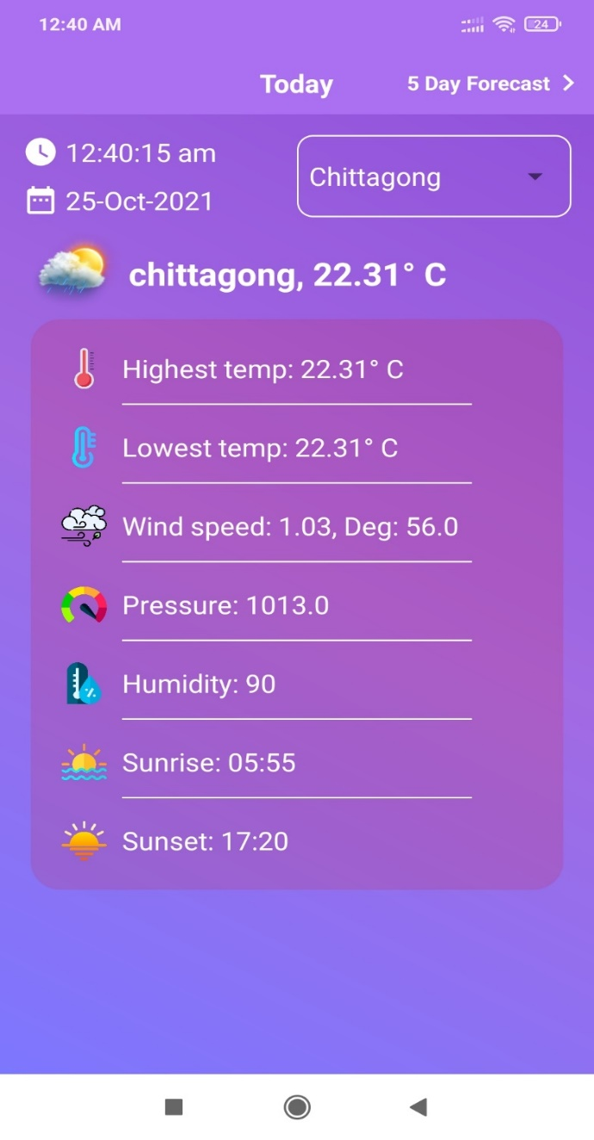
How the proposed system will work (Feature)
Weather of Dhaka City
Weather of Chittagong

Slide 9
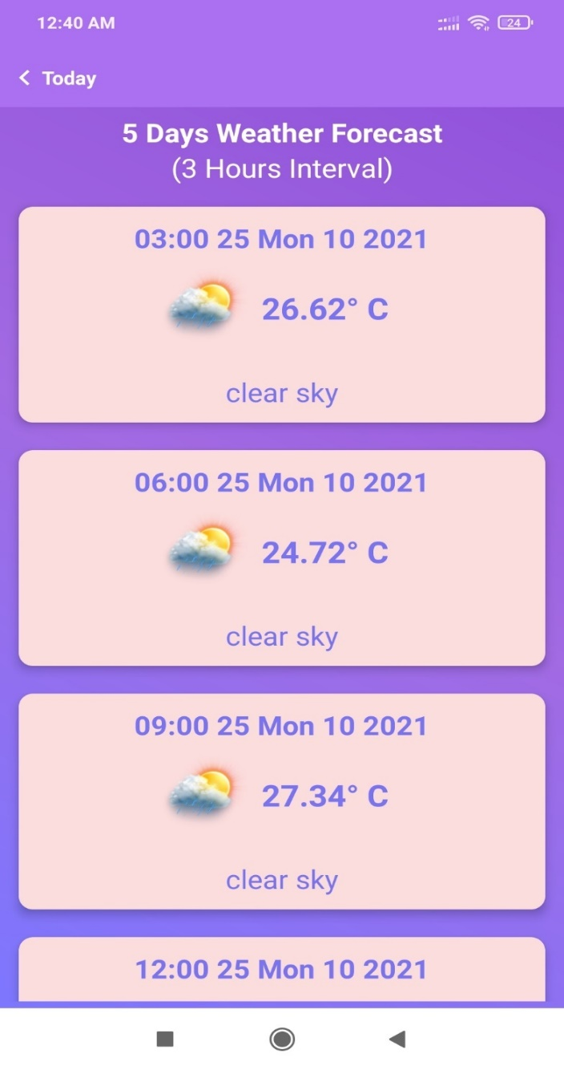
Feature (continue…)
5 Days Forecast with 3 hours Interval

Slide 10
Date of completion
I will finished up to the detection and evaluation of my proposed work within October 14, 2019.

Slide 11
Conclusion
To become a developed country, the country must rely on technology. Using technology in environment & geography will make a nation one step ahead to become a developed nation. If everyone uses a smart online based weather app, they will be benefitted in many ways as mentioned in the purpose of this application.

Slide 12
Thank you

